Slide 1
Hydrology
Introduction

Slide 2
Water – A few interesting Quotes
Water is the driver of Nature. - Leonardo da Vinci
We forget that the water cycle and the life cycle are one. - Jacques Cousteau
When the well's dry, we know the worth of water. - Benjamin Franklin
Thousands have lived without love, not one without water – W.H. Auden
Study how water flows in a valley stream, smoothly and freely between the rocks. Also learn from holy books and wise people. Everything - even mountains, rivers, plants and trees - should be your teacher. Morihei Ueshiba
A river seems a magic thing. A magic, moving, living part of the very earth itself - Laura Gilpin - From The Rio Grande, 1949

Slide 3
Water
Water is in the Western World an unappreciated, but essential resource without which we have no hope of doing anything at all
A quick look at history shows that civilizations flourish when water is abundant
In the developing world (and increasingly the developed) it is the number one source of conflict – and a rather unknown but powerful ISIS and Taliban recruiting weapon
Yesterday I watched a panel with CEO’s from some of the world’s biggest corporations and three of them said – invest in water – it is the Gold of this coming century (e.g. Peter Diamandis, Xprize ). If you want a bleaker view google ‘Nestle CEO water’ : http://themindunleashed.org/2014/05/nestle-ceo-water-human-right-privatized-2.html

Slide 4

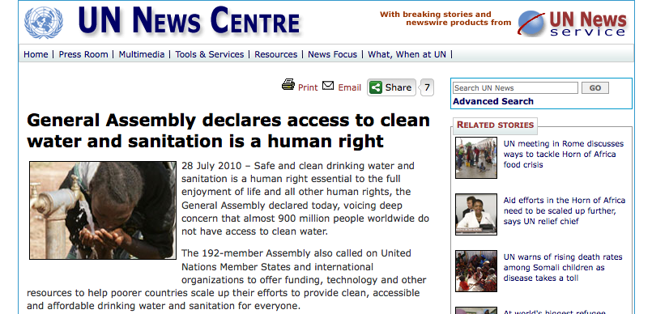
Water and the UN

Slide 5
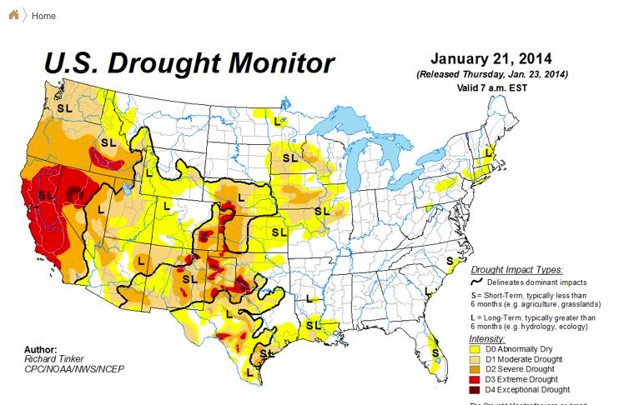
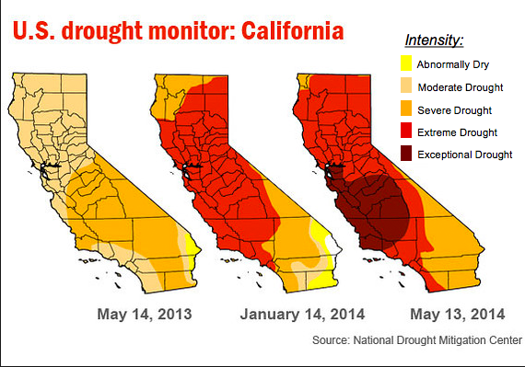
Yes, but if we were selfish…. Why Should We Care?

Slide 6
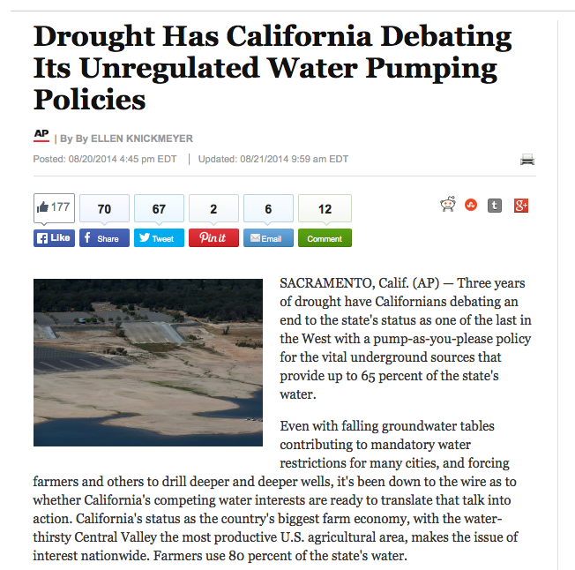

Slide 7
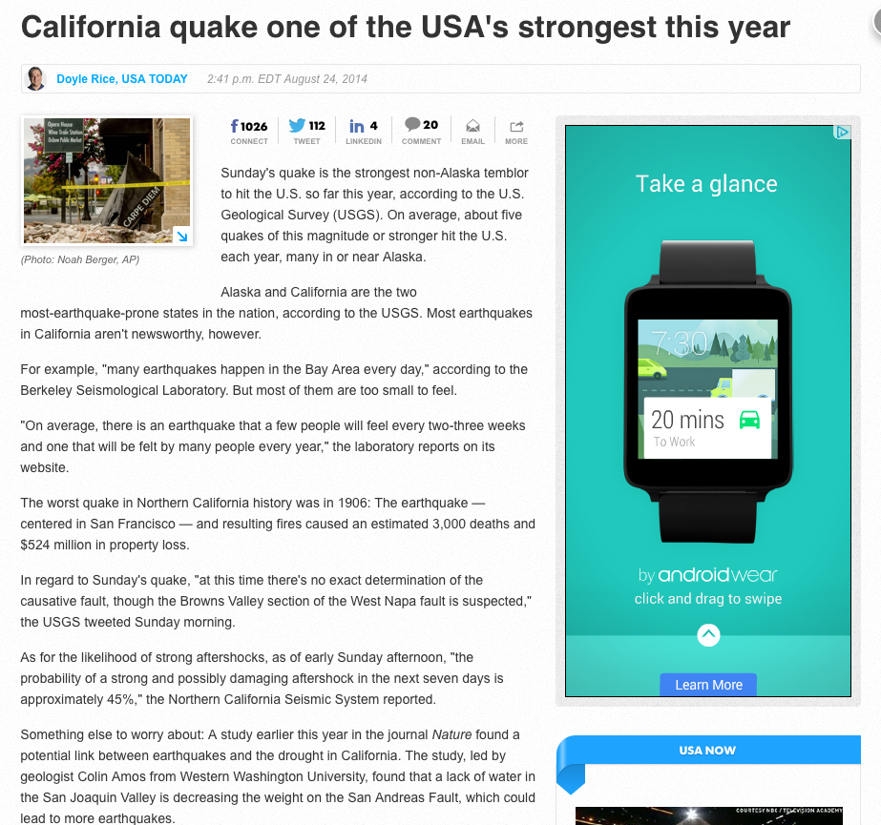

Slide 8
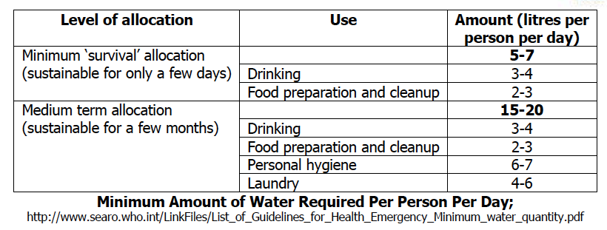
How much do we need?
For personal drinking – roughly 2-3 liters of water a day
In developing countries, 20 to 30 litres of water per person per day are considered adequate for basic human needs

Slide 9
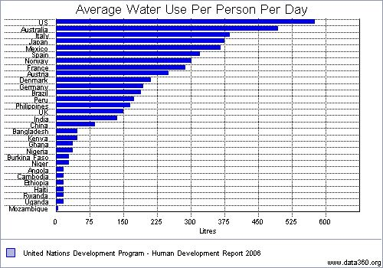
How much do we use?

Slide 10
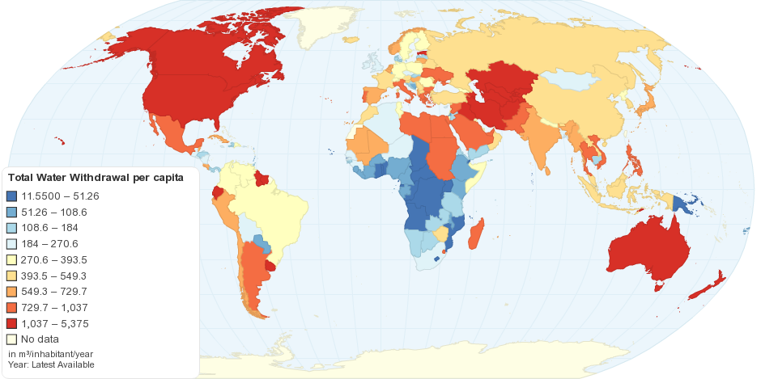
Slightly different view
http://chartsbin.com/view/1455

Slide 11
http://pubs.usgs.gov/circ/1405/pdf/circ1405.pdf

Slide 12
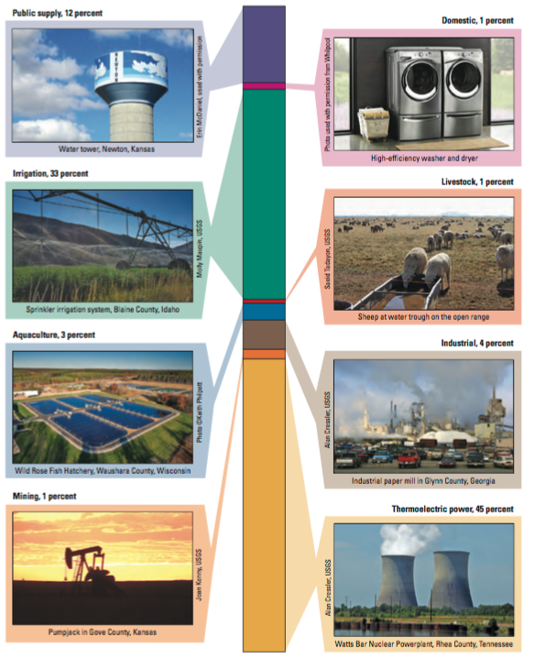
Biggest Users:
ThermoElectric Power – 45%
Irrigation 33%

Slide 13
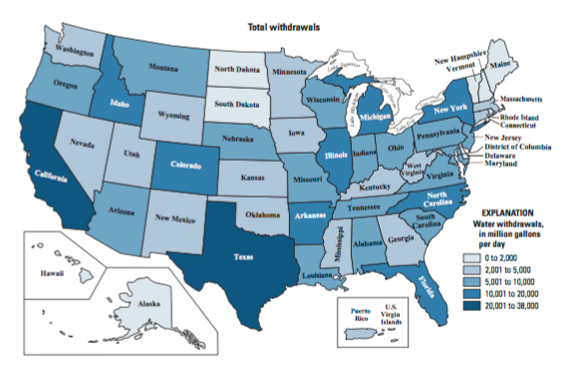
Where and how much?

Slide 14
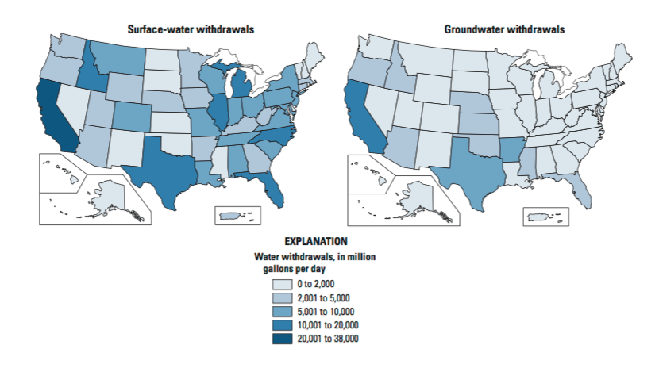
Surface vs Groundwater?
Note that surface is bigger than groundwater, yet we often hear groundwater bigger – why?

Slide 15
And…..
Good News : We are getting more efficient
Our 1995 per capita use was 10% better than our 1980use ; 2010 was again about 10-20% better than this - it is continuously getting better
Bad News : Population growth makes per capita efficiency even more important

Slide 16
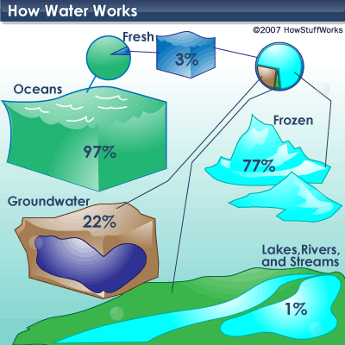
Supply of Water Resources
For more exact numbers see
http://water.usgs.gov/edu/earthhowmuch.html

Slide 17

Some Qualitative Perspective
If all the water in the world was described by the height of the empire state building (Height =100%)

Slide 18

Some Qualitative Perspective
If all the water in the world was described by the height of the empire state building (Height =100%)
The amount of groundwater would be approximately the height of a person

Slide 19
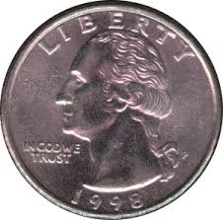
Some Qualitative Perspective
If all the water in the world was described by the height of the empire state building (Height =100%)
The amount of groundwater would be approximately the height of a person
The amount of fresh surface water would be approximately the height of a quarter

Slide 20
Groundwater
More than 98% of readily available fresh water is ground water!
However, it is important not to forget that water follows a cycle

Slide 21
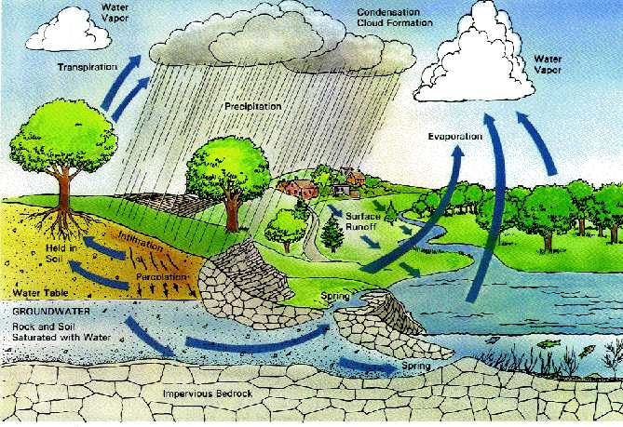
Hydrologic Cycle

Slide 22
Water Budgets
Probably the most important equation in water management, the Hydrologic Equation (or simply Mass Conservation)
Inflow
=
Outflow
+
Changes in Storage

Slide 23
No easy task
Precipitation
Surface Water Flows
Groundwater Flows
Artificial Import and Export of Water
Storage: streams, lakes, ponds, soil moisture, ice +snow, temporary depression storage, plants, groundwater

Slide 24
Where would you work as a hydro(geo)logist
Government (local authorities, USGS, EPA, research labs)
Consulting
Energy
Mining
NGOs
Academia
Cross-disciplinary problems

Slide 25
Question to All of You
What role do Engineers play in Water?
Who owns water?
Is water an engineering problem?
Can we solve the problems?
What barriers do you foresee?
How can we help the politicians, stakeholders and sociologists?
Is this a developed world, developing world or whole world problem?
What role do you personally see yourself playing?

Slide 26
Some Interesting Websites
When I first taught this course six years (yes that recently) if you typed ’water news’ in GOOGLE you would get a few specific new stories that could span the several last years.
Today you get several dedicated webpages with nothing but current news
i.e.

Slide 27
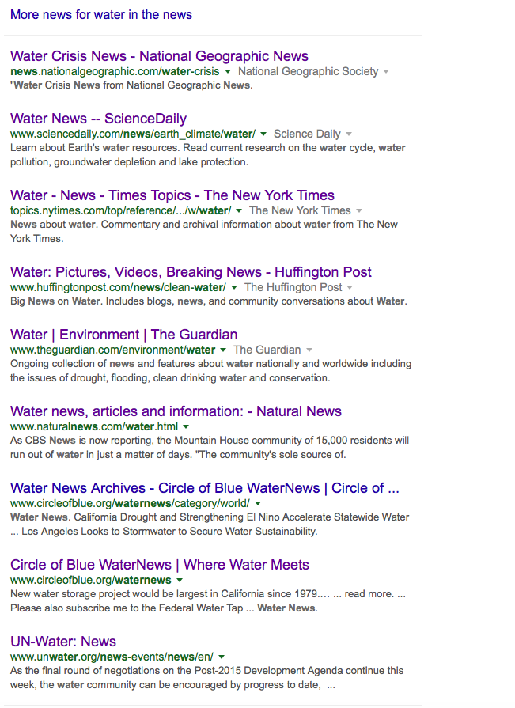
We are going to read at least one such article for every class. I will try to mix things up, but certain topics will come up over and over again. Rather than getting frustrated by any such repetition try to learn that this is simply a reflection of how important these things are…
Also – any time you hear of something interesting or find a good article please feel free to pass it along. My list is continually updated and not set in stone.
I want this to be where you learn why the more boring maths and physics matters* and to help motivate you through these when you’re frustrated by them – yes differential equations can help make peoples’ lives better, even if your maths class did not make it look like that!
*I say this even though this is what I love – Olivia can atest to that

Slide 28
So that you all know my philosophy on teaching:
I do not care about grades – if you work hard you will do just fine – trust me and do not worry about this.
I do not care about simply filling you with information that you can then feed back to me. I am certain you are all capable of this
I want you to understand - EVERYTHING! And I mean understand.
When you do not – stop me – hold me accountable and make me do my job properly. I would rather teach you half the planned content to the highest possible standard, than everything poorly.
In case you do not know, I am Irish (born and raised in Dublin) and one of the greatest Irish poets of the modern era, William Butler Yeats, whose poems inspired a revolution, once said

Slide 29

Let it burn and burn brightly.*
*Cheesy but true

